Slide 1
Microorganisms

Slide 2
Information
Planning and Carrying Out Investigations
Analyzing and Interpreting Data
Engaging in Argument from Evidence
2. Cause and Effect
3. Scale, Proportion, and Quantity

Slide 3
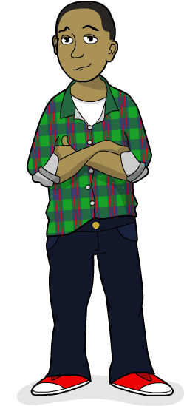
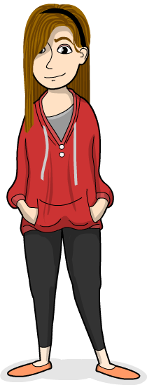
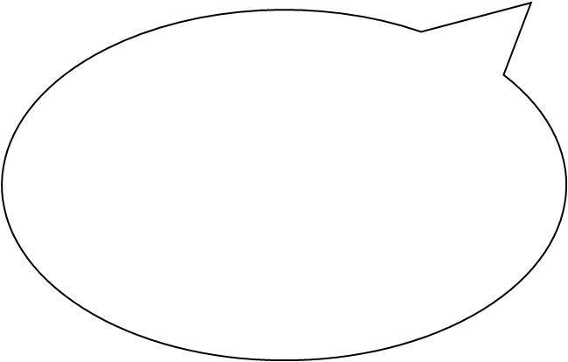
What are microorganisms?
Germs, bacteria, viruses, microbes… whatever you call them, these tiny living things can be found everywhere!
Some microorganisms are harmful and some are helpful. Let’s take a closer look at some.

Slide 4
How do we see microorganisms? (1)

Slide 5
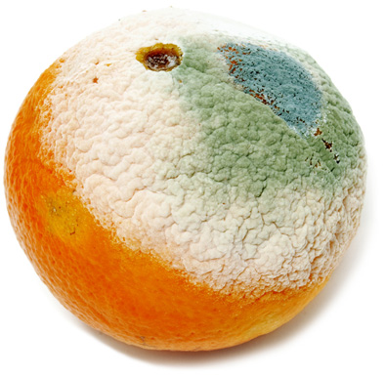
How do we see microorganisms? (2)
Microorganisms live all around us. When we can see them, we are seeing a big colony of millions growing together.
Microorganisms can cause food to decay.
Mold is a microorganism you often see on decaying food. There are other microorganisms called bacteria that also make food decay and can make you ill. Those you can’t see, but can usually smell.
Notes:
Photo credit: © nito, Shutterstock.com 2018

Slide 6
Being hygienic
Notes:
Teacher notes
Students could take turns to drag a warning sign to a hazard they have spotted. Hygiene hazards in this kitchen scene include: microorganisms on dirty plates; microorganisms on spilled jelly; dirty knife can spread microorganisms if used on other food; flies will spread microorganisms from decaying food in the garbage can; microorganisms can spread from one food to another if they are touching (particularly note the raw chicken, which contains microorganisms).
After students have identified and discussed the various hygiene hazards, use the term bacteria to discuss food poisoning.
This slide covers the Science and Engineering Practices:
Analyzing and Interpreting Data: Analyze and interpret data to make sense of phenomena, using logical reasoning, mathematics, and/or computation.
Engaging in Argument from Evidence: Construct and/or support an argument with evidence, data, and/or a model.

Slide 7
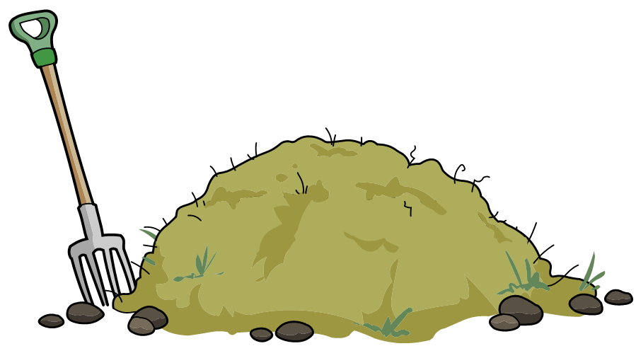
Decomposition
Microorganisms decompose dead organisms by breaking them down. This compost pile contains yard waste and food scraps.
Once the organisms are broken down, the nutrients can be added to soil to feed new plants and help them grow well. That’s nature’s way of recycling!
Notes:
Teacher notes
You might ask students what types of things they might expect to find in a compost heap. Suggestions include fruit and vegetable peels, pulled weeds and grass clippings. Emphasize that microorganisms help to release the nutrients stored in this decaying matter so that they can be used again.

Slide 8
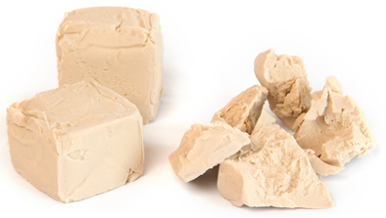
Yeast
This is yeast.
Yeast is made up of millions of single-celled organisms.
Unlike many microbes, yeast is very useful to us. We use yeast in our food!
Notes:
Photo credit: © KariDesign, Shutterstock.com 2018

Slide 9
How do we use yeast? (1)
Notes:
Teacher notes
Encourage students to comment on the process taking place in this animation. Students could discuss why they think the dough with yeast gets bigger.
This slide covers the Science and Engineering Practices:
Planning and Carrying Out Investigations: Make observations and/or measurements to produce data to serve as the basis for evidence for an explanation of a phenomenon or test a design solution.
Analyzing and Interpreting Data: Analyze and interpret data to make sense of phenomena, using logical reasoning, mathematics, and/or computation.

Slide 10
How do we use yeast? (2)

Slide 11
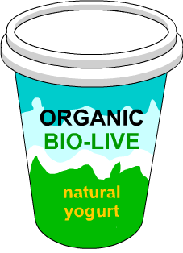
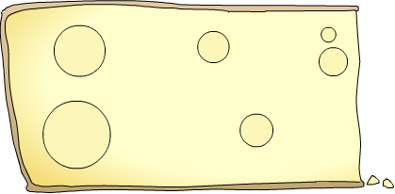
Useful microbes
It’s not just bread that uses microorganisms. Many other foods are produced using microbes.
Some yogurt contains “friendly”
bacteria that help to keep you healthy.
Cheese production requires the use of bacteria. Some cheeses contain a type of mold that we can eat.

