Slide 1
Sun, Moon and Stars

Slide 2
Information
Asking Questions and Defining Problems
Planning and Carrying Out Investigations
Analyzing and Interpreting Data
Constructing Explanations and Designing Solutions
Engaging in Argument from Evidence
Obtaining, Evaluating, and Communicating Information
1. Patterns
2. Cause and Effect
7. Stability and Change

Slide 3
Sunlight
Will the Sun shine through this window in the same place all day?
You can find out for yourself.
Choose a sunny window in your classroom or at home.
On a sunny day, put an object in front of the window so that the Sun shines on it.
After a few hours, check the object again. Is the Sun still shining on it?
Notes:
Teacher notes
SAFETY WARNING: Tell students never to look directly at the Sun, as doing so may cause blindness.
You could extend this experiment over a longer period to find out whether the Sun follows a regular pattern. Students could carry out their experiment on every sunny day over a period of two weeks. Ask them to think of a way of recording their observations e.g. by making sure that the object is always in the sunlight, and recording its position each time. At the end of the period, question students about observations and whether the Sun appears to move in a regular way.
This slide covers the Science and Engineering Practices:
Asking Questions and Defining Problems: Ask and/or identify questions that can be answered by an investigation.
Planning and Carrying Out Investigations: With guidance, plan and conduct an investigation in collaboration with peers.
Planning and Carrying Out Investigations: Make observations (firsthand or from media) to collect data that can be used to make comparisons.
Analyzing and Interpreting Data: Use observations (firsthand or from media) to describe patterns and/or relationships in the natural and designed world(s) in order to answer scientific questions and solve problems.
Photo credit: © Dmitry Zimin, Shutterstock.com 2018

Slide 4
The Sun in the sky
Notes:
This slide covers the Science and Engineering Practices:
Analyzing and Interpreting Data: Use observations (firsthand or from media) to describe patterns and/or relationships in the natural and designed world(s) in order to answer scientific questions and solve problems.
Engaging in Argument from Evidence: Construct an argument with evidence to support a claim.

Slide 5
Shadows (1)
Notes:
Teacher notes
It may be necessary to remind students that the Sun rises in the East and sets in the West.
For ease of explanation, the shadow in this activity is shown as it would appear in the southern hemisphere.
This slide covers the Science and Engineering Practices:
Analyzing and Interpreting Data: Use observations (firsthand or from media) to describe patterns and/or relationships in the natural and designed world(s) in order to answer scientific questions and solve problems.
Engaging in Argument from Evidence: Construct an argument with evidence to support a claim.

Slide 6
Shadows (2)
Notes:
This slide covers the Science and Engineering Practices:
Constructing Explanations and Designing Solutions: Use tools and/or materials to design and/or build a device that solves a specific problem or a solution to a specific problem.
Engaging in Argument from Evidence: Construct an argument with evidence to support a claim.
Obtaining, Evaluating, and Communicating Information: Communicate information or design ideas and/or solutions with others in oral and/or written forms using models, drawings, writing, or numbers that provide detail about scientific ideas, practices, and/or design ideas.

Slide 7
The Sun and seasons
Notes:
Teacher notes
This diagram is drawn from the perspective of someone in the northern hemisphere looking south.
After showing the path during the summer, ask students to predict the path during the other seasons. Have students use the pen tool to draw their predictions on the diagram before continuing with the animation.
This slide covers the Science and Engineering Practice:
Constructing Explanations and Designing Solutions: Use information from observations (firsthand and from media) to construct an evidence-based account for natural phenomena.

Slide 8
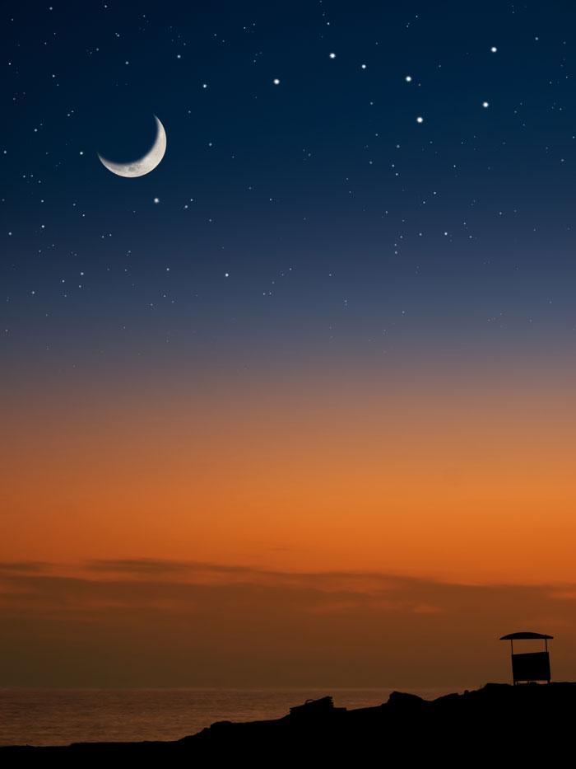
Patterns (1)
Objects in the sky follow predictable patterns. What patterns do you know about already?
The Sun moves across the sky every day, from East to West.
As the seasons change, the position of the Sun in the sky also changes.
Like the Sun, the position of the Moon and stars in the sky also changes over time.
Notes:
Photo credit: © Vladimir Koletic, Shutterstock.com 2018

Slide 9
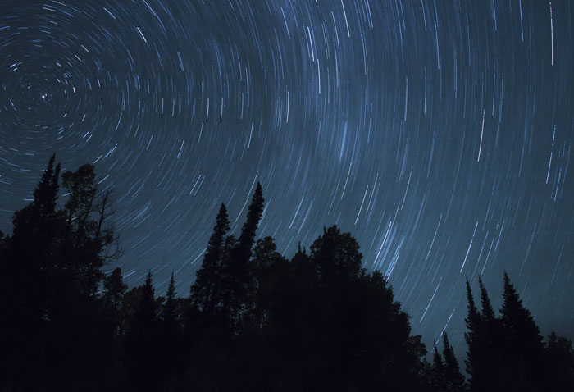
Patterns (2)
The Moon and stars appear to move across the sky every night, from East to West.
Some special types of photograph can show us how the stars appear to move!
Like the stars, the Moon also seems to move across the sky every night.
But unlike the stars, the appearance of the moon also changes in a pattern that repeats every four weeks.
Notes:
Photo credit: © Wes Bagwell, Shutterstock.com 2018

Slide 10
The Moon

