Slide 1
Protecting Our Planet

Slide 2
Information
Analyzing and Interpreting Data
Using Mathematics and Computational Thinking
Engaging in Argument from Evidence
Obtaining, Evaluating and Communicating Information
1. Patterns
2. Cause and Effect
7. Stability and Change

Slide 3
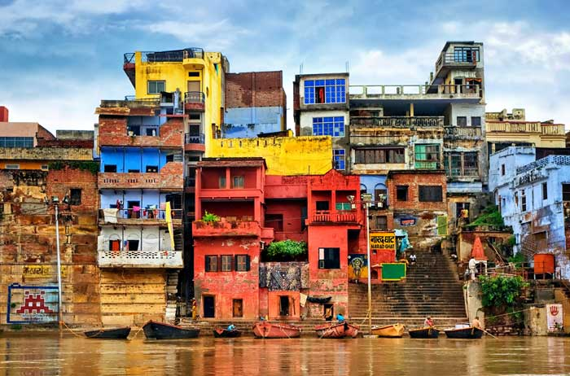
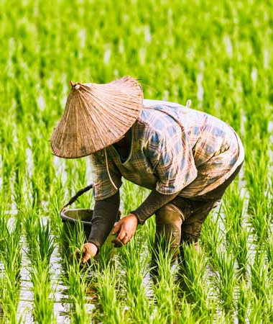
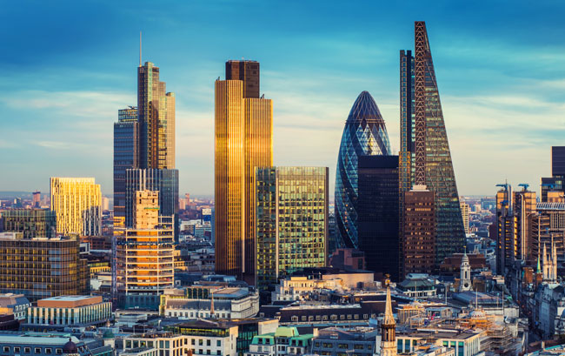
Protecting our planet
Human communities all over the world extract and use Earth’s natural resources.
We all depend on them for our everyday lives, however different they may be!
Notes:
Teacher notes
Ask students to describe ways in which Earth’s natural resources are being used in the images shown. Answers could include the materials used to make the buildings, or the clothes worn by the farmer, as well as the soil, rain and sunlight used to grow the rice crop.
Photo credit: Varanasi, India © Boris Stroujko; Rice farmer © FenlioQ; London, UK © ZGPhotography, all Shutterstock.com 2018

Slide 4
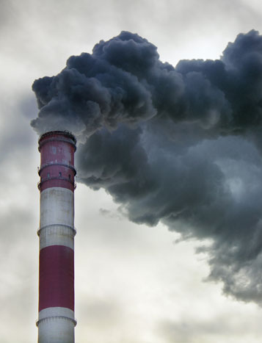
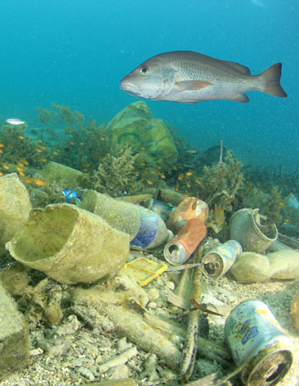
Protecting our planet
Human communities all over the world have also had a large impact on the natural environment.
Can you think of any examples?
Notes:
Teacher notes
Explain that humans have impacted Earth’s air, water and land environments. The effects of human activities on the natural environment are discussed in the presentation Impacts of Human Activity.
This slide covers the Science and Engineering Practice:
Engaging in Argument from Evidence: Construct and/or support an argument with evidence, data, and/or a model.
Photo credit: Smoking chimney © Anastasiia Tymoshenko; Marine pollution © Rich Carey; Palm oil plantation © Rich Carey, all Shutterstock.com 2018

Slide 5
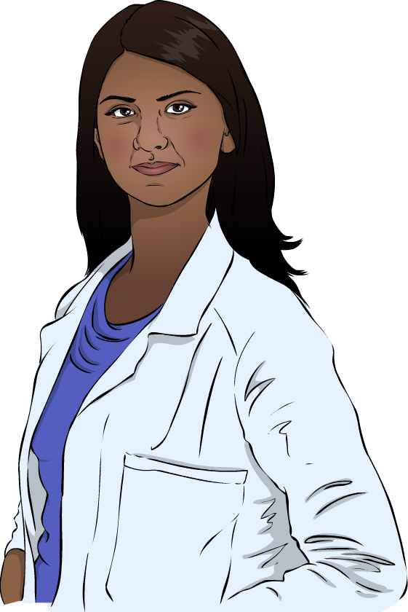
Protecting our planet
Some people and communities are taking steps to protect Earth’s natural environment and its resources.
One way to do this is to use ideas from science to understand problems and come up with a solution.
This approach can be applied in many different areas.

Slide 6
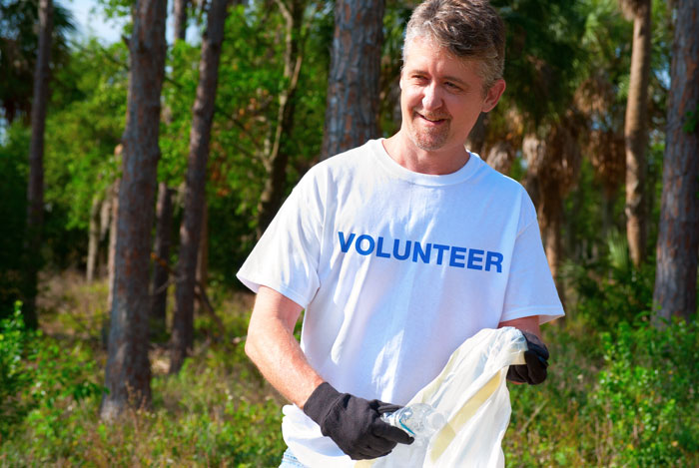
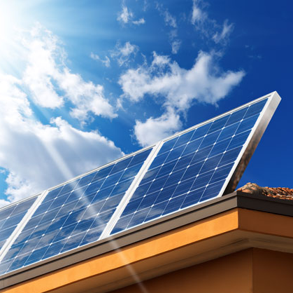
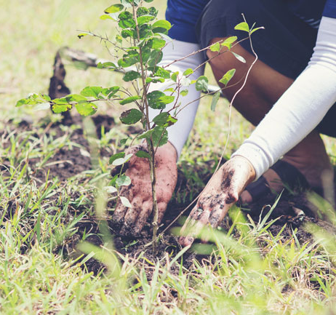
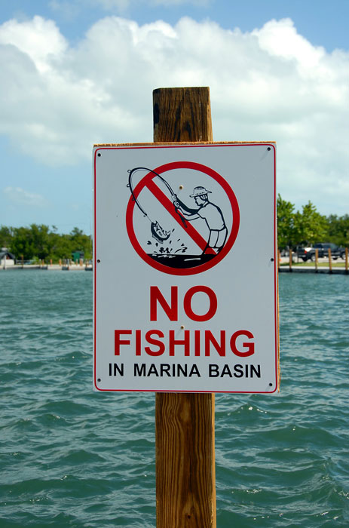
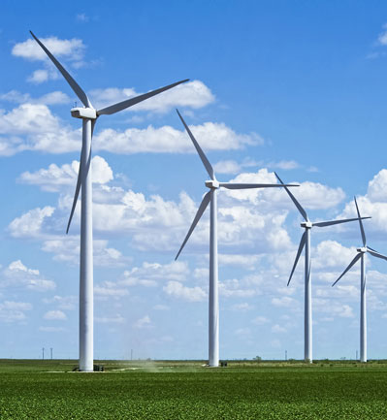
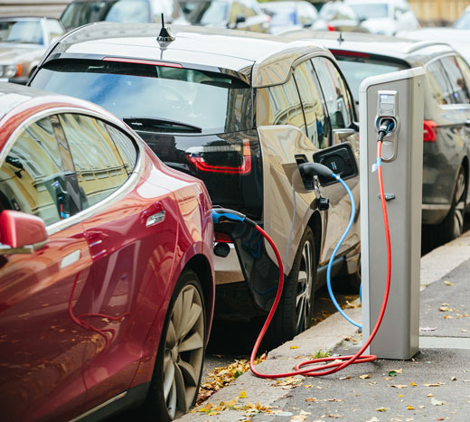
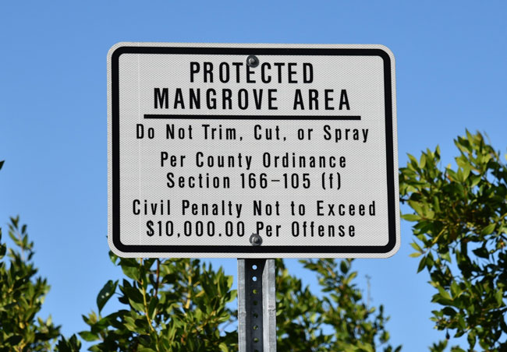
Protecting our planet
Can you describe any solutions shown in this set of 7 images?
Notes:
Teacher notes
The examples show a volunteer cleaning up litter, solar cells, a wind farm, protected areas and electric cars. Discuss the ways in which each image shows something that helps to protect Earth’s resources, or the natural environment. You could explain how these are underpinned by scientific concepts, such as the impacts of burning fossil fuels, or disrupting ecosystems, as well as the technologies involved in designing solutions to these issues.
This slide covers the Science and Engineering Practices:
Engaging in Argument from Evidence: Construct and/or support an argument with evidence, data, and/or a model.
Obtaining, Evaluating, and Communicating Information: Communicate scientific and/or technical information orally and/or in written formats, including various forms of media and may include tables, diagrams, and charts.
Photo credit: Cleanup volunteer © Mike Focus; Solar cells © Alberto Masnovo; No fishing sign © Paul Brennan; Tree planting © boonchoke; Wind farm © W. Scott McGill; Protected area sign © Stasy; Electric cars © Scharfsinn, all Shutterstock.com 2018

Slide 7
Protecting our planet
Design an information leaflet to explain ONE way in which Earth’s resources or the natural environment are being protected.
Research why your chosen method is needed. What problem does it solve?
Explain how your method works.
Give some examples of where your method is being used.
Notes:
This slide covers the Science and Engineering Practices:
Engaging in Argument from Evidence: Construct and/or support an argument with evidence, data, and/or a model.
Obtaining, Evaluating, and Communicating Information: Obtain and combine information from books and/or other reliable media to explain phenomena or solutions to a design problem.
Obtaining, Evaluating, and Communicating Information: Communicate scientific and/or technical information orally and/or in written formats, including various forms of media and may include tables, diagrams, and charts.

Slide 8
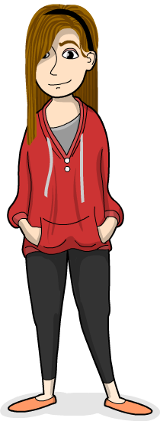
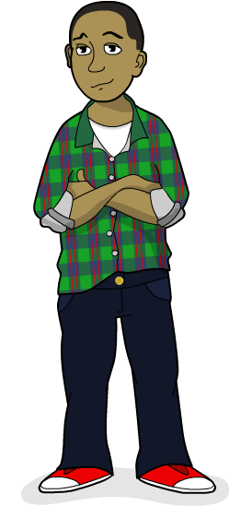
Protecting our planet
Some ideas to protect Earth’s resources can be carried out by local communities.
Everybody uses Earth’s resources, so one way to protect them is for everyone to make better use of the ones we have already taken.
For example, some things can be used more than once. Reusing an item avoids the need for a new one to be made.
Can you think of any examples of reusing?
Notes:
Teacher notes
Examples of reusing include: donating clothes to thrift stores and buying used items from them; rechargeable batteries; reusable grocery bags; cleaning and reusing food packaging for use as storage jars.

Slide 9
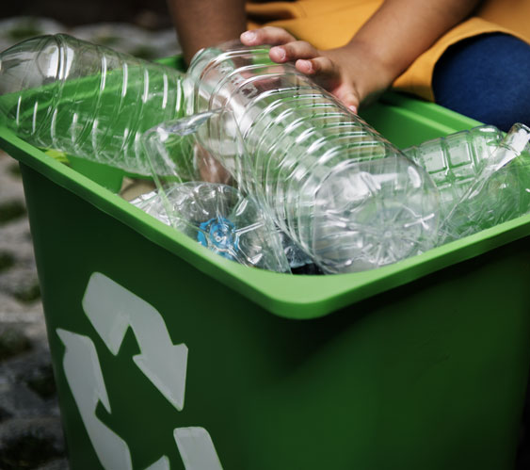
Protecting our planet
Some items that are no longer needed can be recycled.
Recycling is the process of turning a waste material back into something useful. This avoids the need to use new materials.
For example, used plastic bottles can be melted down.
Then, they can be turned into new bottles and containers.
Many different types of materials can be recycled.
Notes:
Photo credit: © Rawpixel.com, Shutterstock.com 2018

Slide 10
Protecting our planet
Notes:
This slide covers the Science and Engineering Practices:
Analyzing and Interpreting Data: Represent data in tables and/or various graphical displays (bar graphs, pictographs, and/or pie charts) to reveal patterns that indicate relationships.
Using Mathematics and Computational Thinking: Organize simple data sets to reveal patterns that suggest relationships.

Slide 11
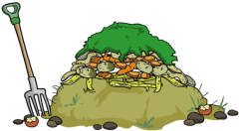
Protecting our planet
There are many ways to recycle.
Compost: organic waste is put onto a compost heap to decay. Compost can be used to help plants grow.
Pulp: paper can be crushed into a soft, wet pulp. Pulp can be used to make more paper.
Melt down: metal, glass and plastic can be melted down so that the material can be used again.
Items that can’t be recycled are sent to a landfill. Trash is buried in the ground and covered with dirt.

Slide 12
Pollution
So 79 of the 85 items could have been recycled!
Notes:
Teacher notes
Ask students to discuss and define the terms melt down, pulp, compost and landfill in pairs before completing the onscreen labeling task. The class could vote on how to deal with the different types of trash. When the task has been completed, ask, “Which type of trash could not be recycled?” (landfill waste).
This slide covers the Science and Engineering Practice:
Analyzing and Interpreting Data: Analyze and interpret data to make sense of phenomena, using logical reasoning, mathematics, and/or computation.

Slide 13
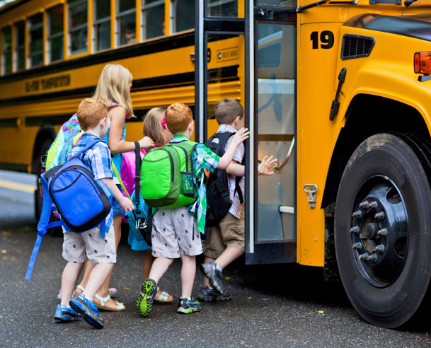
Protecting our planet
Another way to protect Earth’s resources is to use less of them.
This means that fewer resources will need to be removed from Earth.
Can you think of any ways to reduce the amount of resources you use in your everyday life?
Notes:
Teacher notes
Examples of reducing resource use include: using public transport instead of driving; swapping disposable beverage cups with a reusable one; switching off appliances when not in use; maintaining or repairing products so that they last longer; sharing items with others.
Photo credit: © Stuart Monk, Shutterstock.com 2018

Slide 14
Protecting our planet

Slide 15
Protecting our planet
Design a poster to show ONE way in which local communities can protect Earth’s resources or the natural environment.
Research your chosen method to understand how it could help to protect Earth’s resources or the natural environment.
Describe how your chosen method would work and explain why local communities should use it.
Notes:
This slide covers the Science and Engineering Practices:
Engaging in Argument from Evidence: Construct and/or support an argument with evidence, data, and/or a model.
Obtaining, Evaluating, and Communicating Information: Obtain and combine information from books and/or other reliable media to explain phenomena or solutions to a design problem.
Obtaining, Evaluating, and Communicating Information: Communicate scientific and/or technical information orally and/or in written formats, including various forms of media and may include tables, diagrams, and charts.

