Slide 1
Patterns in Earth’s Features

Slide 2
Information
Developing and Using Models
Analyzing and Interpreting Data
1. Patterns
2. Cause and Effect
7. Stability and Change

Slide 3
Are there any patterns to earthquakes?
Notes:
Teacher notes
You can use this flash activity to show where earthquakes occur automatically by clicking “show earthquake distribution,” or you could give the class some data and ask them to plot this on the map. You could even add to this daily, using real time information on earthquakes from the USGS site: https://earthquake.usgs.gov/earthquakes/map/
If students do not recognize that there a pattern in the data, prompt them by asking if they think that earthquakes are appearing at random locations, dotted around the globe, or whether there seems to be something affecting their distribution.
Consider holding back from asking students straightaway what they think is affecting the distribution, to encourage them to ask questions and suggest solutions.
This slide covers the Science and Engineering Practice:
Analyzing and Interpreting Data: Analyze and interpret data to make sense of phenomena, using logical reasoning, mathematics, and/or computation.

Slide 4
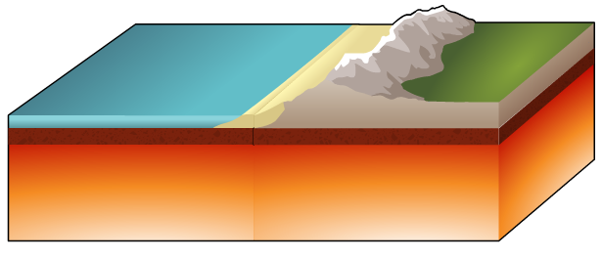
The structure of the Earth
To understand the patterns in earthquake distribution, we need to look at the structure of the Earth.
The Earth is made up of different layers.
The crust is the thin, rocky outer layer.
Crust
This sits on top of the Earth’s mantle.
Mantle

Slide 5
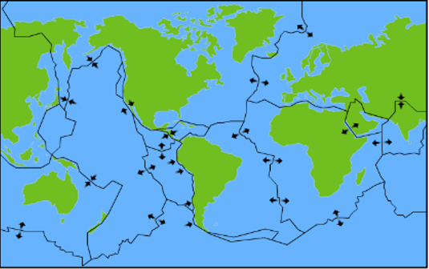
Tectonic plates
The crust is cracked into sections called tectonic plates.
Plates that contain land are known as continental plates. Those that are covered in water are known as oceanic plates.

Slide 6
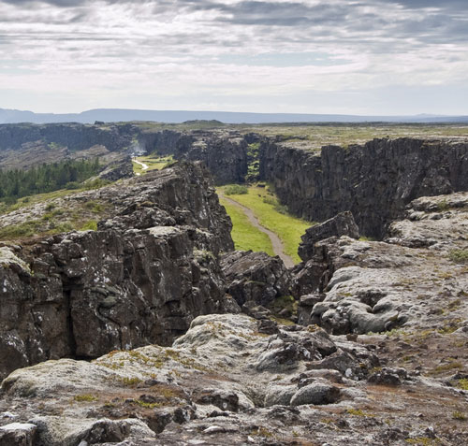
Plate boundaries
Tectonic plates are moving all the time. The area where plates meet is called a plate boundary.
Mountains, volcanoes and oceanic ridges are formed at plate boundaries.
Earthquakes are more likely to occur here too.
What do you think this images shows?
Notes:
Teacher notes
The image shows the site of a rift valley that marks the crest of the Mid-Atlantic Ridge. In this location, the North American and Eurasian tectonic plates meet at a divergent plate boundary. The location shown is the Pingvellir (Thingvellir) National Park in Iceland. Help students to interpret the features shown.
This slide covers the Science and Engineering Practice:
Analyzing and Interpreting Data: Analyze and interpret data to make sense of phenomena, using logical reasoning, mathematics, and/or computation.
Photo credit: © Israel Hervas Bengochea, Shutterstock.com 2018

Slide 7
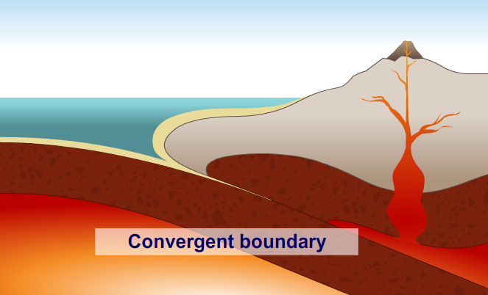
Convergent boundary
When a continental and an oceanic plate move towards each other, this is called a convergent boundary.
As the plates meet, the oceanic plate is forced under the continental plate, where it melts to form magma. This magma can rise to the surface, forming a volcano.
Notes:
This slide covers the Science and Engineering Practice:
Developing and Using Models: Develop and/or use models to describe and/or predict phenomena.

Slide 8
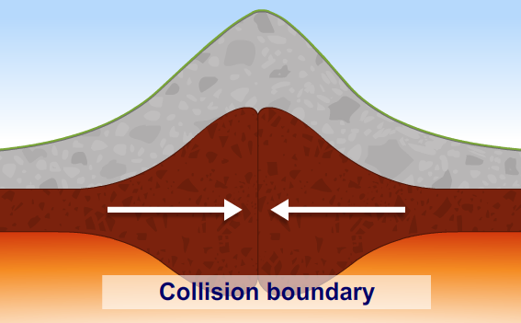
Collision boundary
When two continental plates move towards each other, neither is forced under the other. Instead, the plates buckle upwards and rise to form mountains.
Notes:
Teacher notes
The friction caused by the plates pushing against each other can cause earthquakes.
This slide covers the Science and Engineering Practice:
Developing and Using Models: Develop and/or use models to describe and/or predict phenomena.

Slide 9
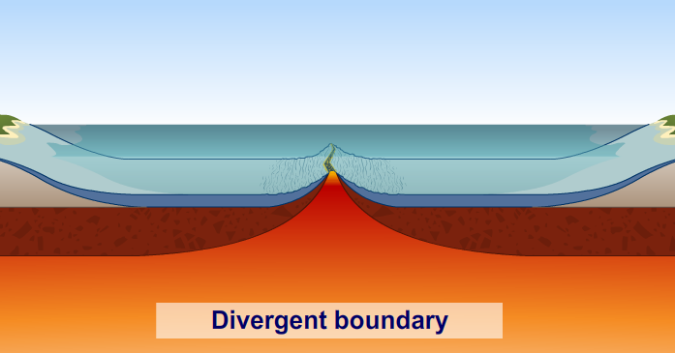
Divergent boundary
When oceanic plates move away from each other, this is called a divergent boundary.
Magma rises from the mantle and solidifies, forming new crust. When this process happens continuously over a long time, new mid-ocean ridges are formed.
Notes:
This slide covers the Science and Engineering Practice:
Developing and Using Models: Develop and/or use models to describe and/or predict phenomena.

Slide 10
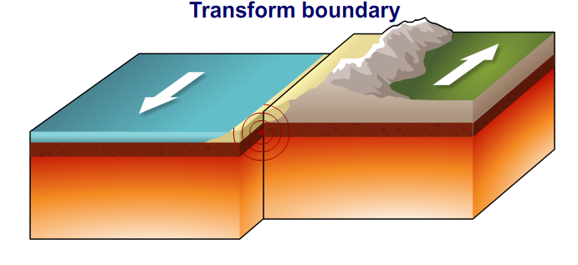
Transform boundary
When two plates move past each other, this is called a transform boundary.
At times, the plates might get stuck and struggle to jolt themselves free. This causes earthquakes.
Notes:
This slide covers the Science and Engineering Practice:
Developing and Using Models: Develop and/or use models to describe and/or predict phenomena.

Slide 11
Earthquakes and volcanoes (1)
Notes:
Teacher notes
In the first stage of the activity, consider asking students to think again about the earthquake distribution shown. Can they now describe the pattern and give reasons for it?
You could then ask them to predict where volcanoes occur, using their knowledge, and ask them to mark them on the map before revealing the answer.
As an extension, you can discuss where mountain ranges and mid-ocean ridges occur.
This slide covers the Science and Engineering Practice:
Analyzing and Interpreting Data: Analyze and interpret data to make sense of phenomena, using logical reasoning, mathematics, and/or computation.

Slide 12
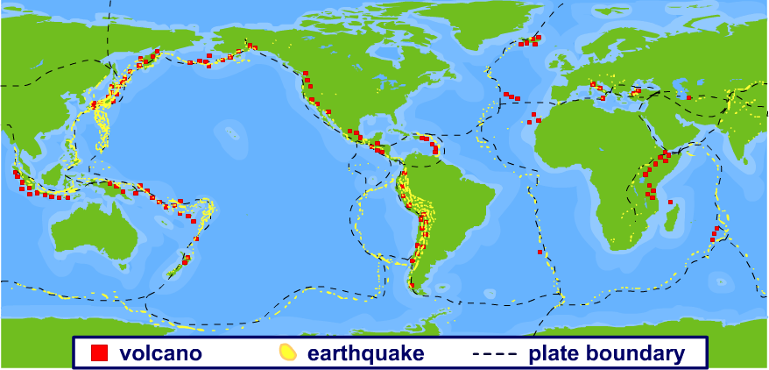
Earthquakes and volcanoes (2)
Many earthquakes and volcanoes occur in bands along the boundaries between continental and oceanic crust.
Major mountain chains form inside continents or near their edges.

