Slide 1
Earth’s Surface

Slide 2
Information
Analyzing and Interpreting Data
Constructing Explanations and Designing Solutions
Obtaining, Evaluating and Communicating Information
3. Scale, Proportion, and Quantity
6. Structure and Function
7. Stability and Change

Slide 3
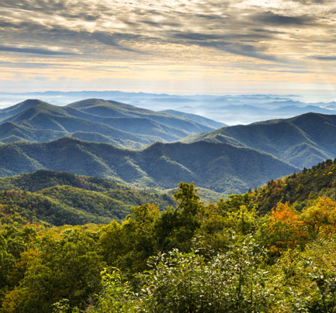
The Earth’s surface
Changes to the Earth’s surface happen at different rates.
Some changes to the land occur very slowly. They take much longer than a single person can observe.
For example, mountain ranges can take 100 million years to form!
Notes:
Teacher notes
Before revealing the examples, ask students if they can think of any changes to the Earth’s surface that occur very slowly.
Photo credit: Blue Ridge Parkway © Dave Allen Photography, Shutterstock.com 2018

Slide 4
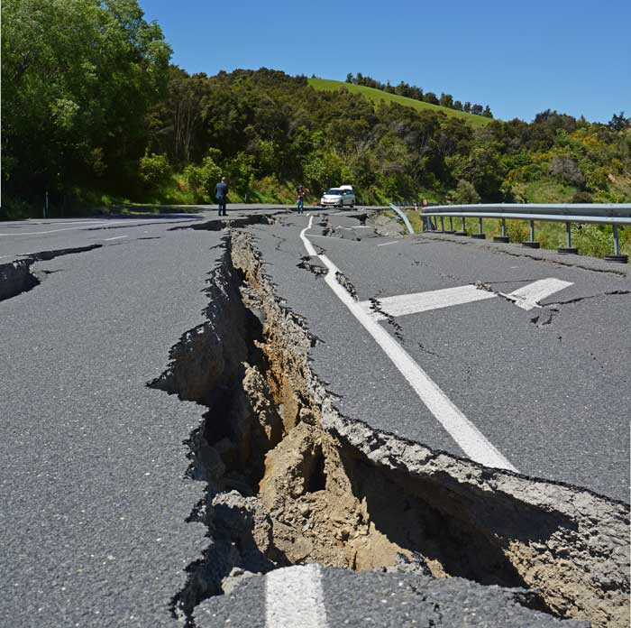
Sudden changes
Other events happen very suddenly.
Can you think of any examples?
Earthquakes or floods can cause very quick changes.
Notes:
This slide covers the Science and Engineering Practice:
Obtaining, Evaluating, and Communicating Information: Communicate information or design ideas and/or solutions with others in oral and/or written forms using models, drawings, writing, or numbers that provide detail about scientific ideas, practices, and/or design ideas
Photo credit: Kaikoura, New Zealand © NigelSpiers, Shutterstock.com 2018

Slide 5
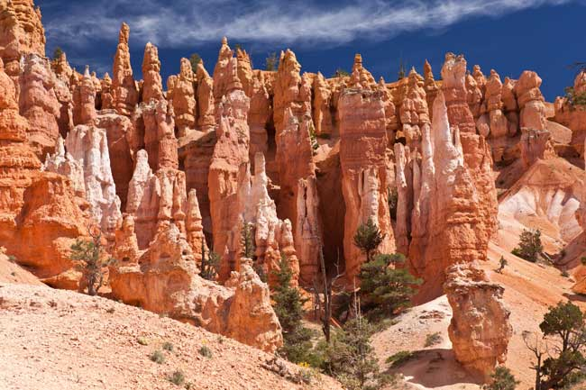
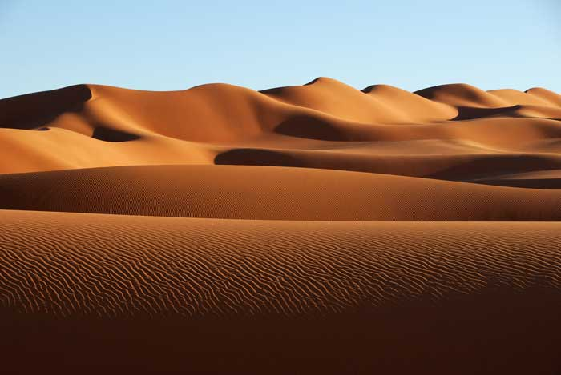
Gradual changes
What do you think has caused these changes to the Earth’s surface?
The power of the wind helped to form these structures, over a long period of time.
Notes:
Teacher notes
If you want to elaborate you could tell students that the structures on the left in Bryce Canyon were formed by the wind eroding the rock (with the help of water too). Whereas the dunes on the right are made by the wind depositing sand from elsewhere.
This slide covers the Science and Engineering Practices:
Constructing Explanations and Designing Solutions: Use information from observations (firsthand and from media) to construct an evidence-based account for natural phenomena.
Obtaining, Evaluating, and Communicating Information: Communicate information or design ideas and/or solutions with others in oral and/or written forms using models, drawings, writing, or numbers that provide detail about scientific ideas, practices, and/or design ideas
Photo credits: Bryce canyon © Berzina; Sand dunes © MrLis, both at Shutterstock.com 2018

Slide 6
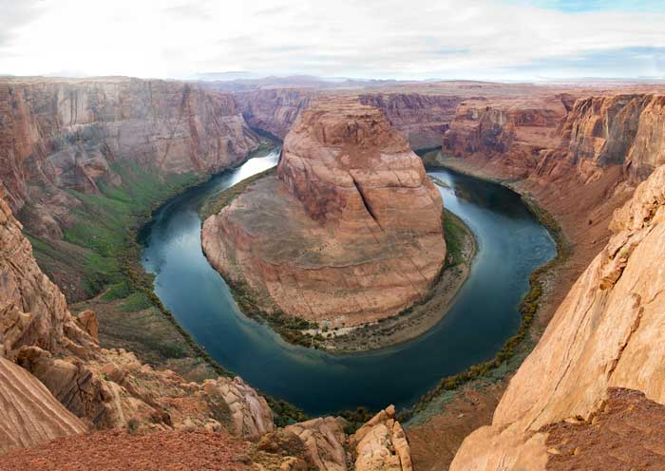
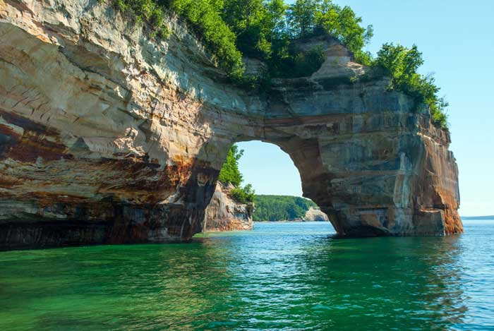
Changes made by water
Water can also shape the land, over thousands of years.
Water can carry away rock and soil, changing the shape of the landscape.
Notes:
Photo credits: Colorado River © IrinaK; Arch of rock © Oleksandr Koretsky, both at Shutterstock.com 2018

Slide 7
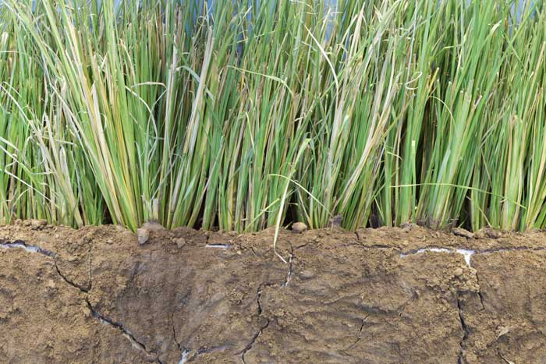
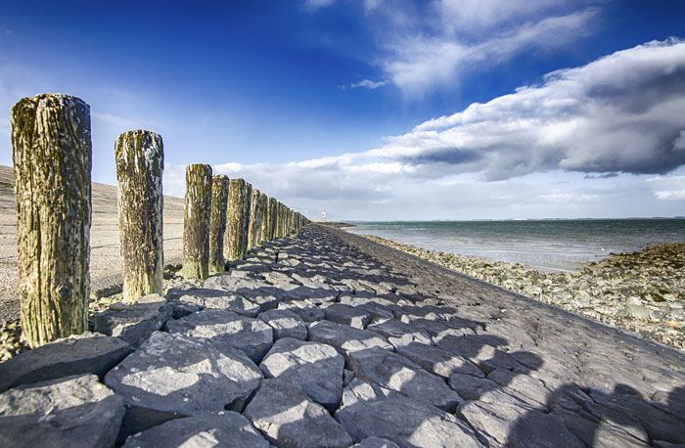
How do we prevent surface change?
Sometimes humans try to slow down or stop wind and water from changing the Earth’s surface.
Trees and plants can be used to try to prevent land being washed or blown away. The roots help to keep soil together.
Structures such as dikes or windbreakers are used to hold back wind or water.
Notes:
Teacher notes
Ask students why they think people might try to slow down or stop these processes.
Photo credits: Grass © 88studio; Coast © Illya Kryzhanivskyy, both at Shutterstock.com 2018

Slide 8
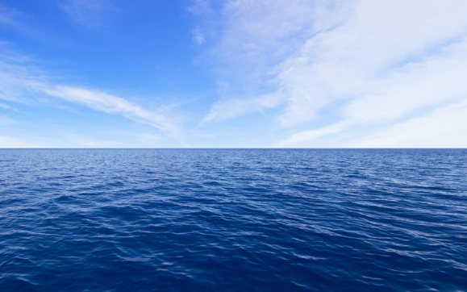
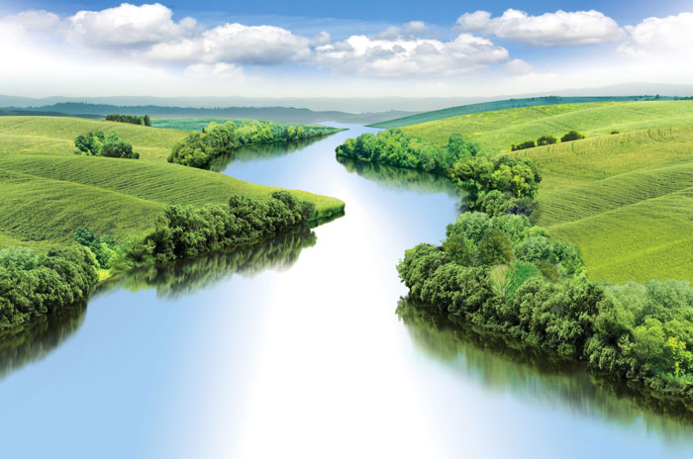
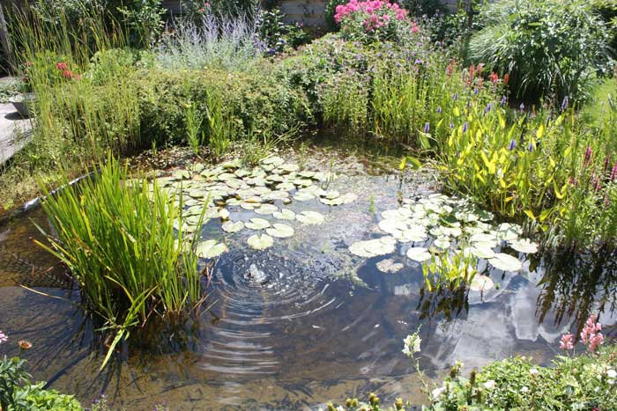
Where is water found?
Water is found in lots of different places on Earth.
Lakes
Oceans
water
Rivers
Ponds
Notes:
Teacher notes
Before revealing the spider diagram, ask students to tell you where water is found.
Photo credits: Mountain landscape © Valerii_M; Ocean and Sky © TouchingPixel; River © Jaros; Pond © Erik Steinebach, all at Shutterstock.com 2018

Slide 9
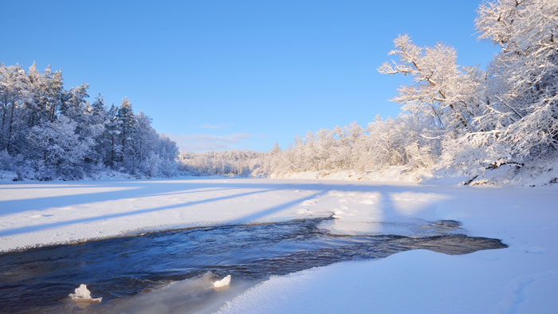
Frozen water
We think of water as being liquid. But is that always the case?
Water exists as solid ice, as well as in liquid form.
Notes:
This slide covers the Science and Engineering Practice:
Analyzing and Interpreting Data: Use observations (firsthand or from media) to describe patterns and/or relationships in the natural and designed world(s) in order to answer scientific questions and solve problems.
Photo credit: Frozen Gauja river © Aleksey Stemmer, Shutterstock.com 2018

Slide 10
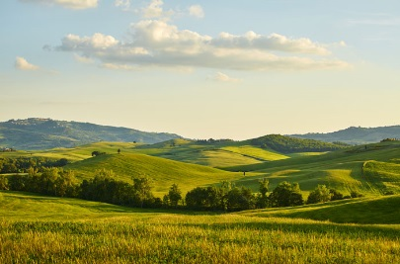
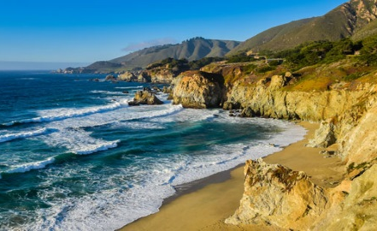
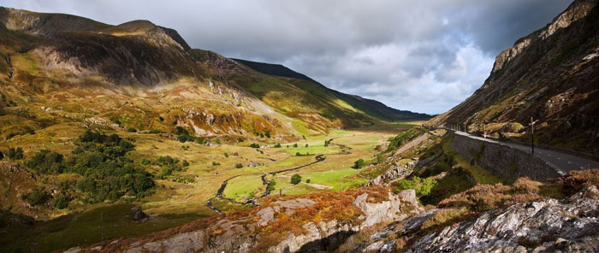
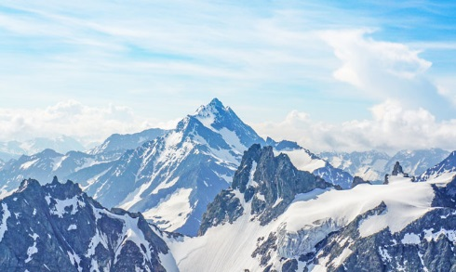
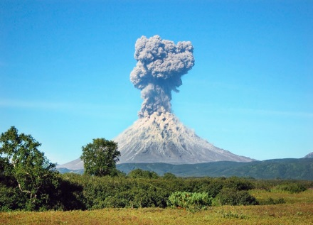
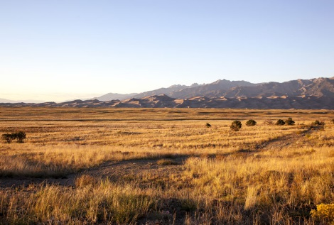
Types of landforms
There are lots of different landforms.
hill
coast
valley
mountain
Land
volcano
plain
Notes:
Photo credits: Hills © Zoom Team; Valley © Matt Gibson; Volcano © LukaKikina; Grasslands © Tim Roberts Photography; Mountains © iamnong; Coast © jejim, Shutterstock.com 2018

Slide 11
Maps
We can use maps to show where things are located.
They also show the shapes and types of water and landforms.
Notes:
Photo credit: © TierneyMJ, Shutterstock.com 2018

Slide 12
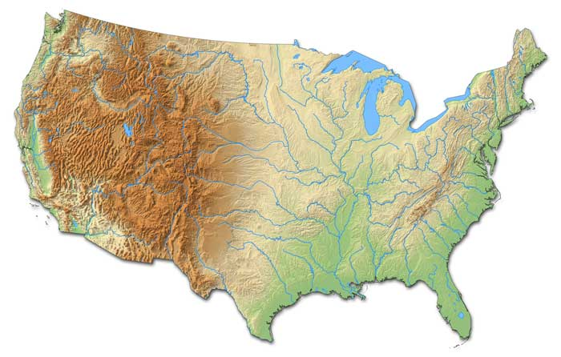
Relief maps
We can show different landforms on a map.
Mountains
Lakes
Relief maps are one way to model landforms, such as mountains.
Coast
Rivers
What other features can you see on this map?
Notes:
This slide covers the Science and Engineering Practices:
Analyzing and Interpreting Data: Use and share pictures, drawings, and/or writings of observations.
Analyzing and Interpreting Data: Use observations (firsthand or from media) to describe patterns and/or relationships in the natural and designed world(s) in order to answer scientific questions and solve problems.
Obtaining, Evaluating, and Communicating Information: Communicate information or design ideas and/or solutions with others in oral and/or written forms using models, drawings, writing, or numbers that provide detail about scientific ideas, practices, and/or design ideas
Photo credit: © Schwabenblitz, Shutterstock.com 2018

Slide 13
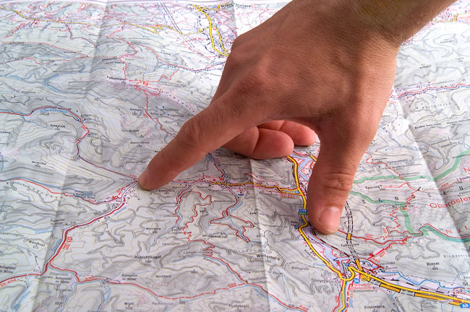
Using maps
Some maps use special symbols to represent larger things in the world.
This includes icons, lines, dots and colors.
Notes:
Teacher notes
For an additional activity, in groups, supply students with maps or atlases and ask them to try and identify any examples of the additional icons and markings.
Photo credit: © Marek CECH, Shutterstock.com 2018

