Slide 1
Changes Over Time

Slide 2
Information
Analyzing and Interpreting Data
Constructing Explanations and Designing Solutions
Engaging in Argument from Evidence
1. Patterns
2. Cause and Effect
6. Structure and Function
7. Stability and Change

Slide 3
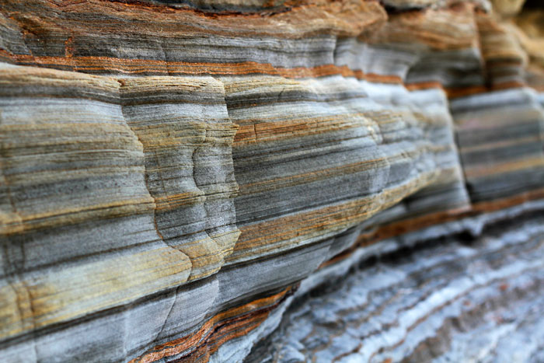
Sedimentary rocks
Some rocks form in layers, these rocks are known as sedimentary rocks.
Sedimentary rocks take thousands of years to form.
Each layer is made when small bits of rock, silt or sand, called sediment, are compacted into rock.
Notes:
Photo credit: © SAPhotog, Shutterstock.com 2018

Slide 4
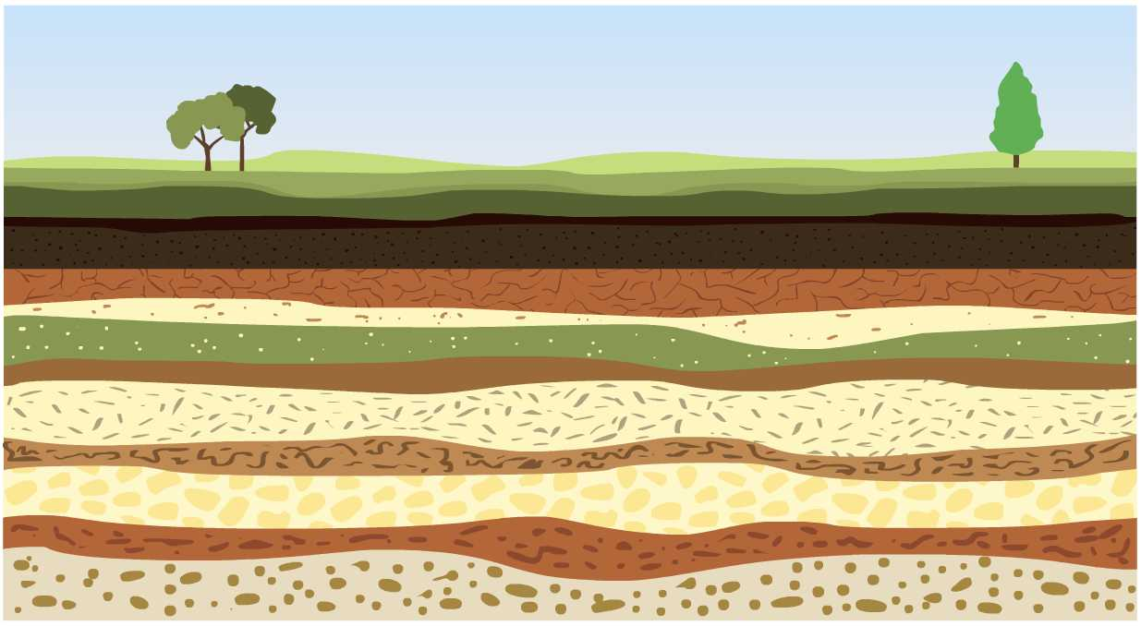
Sedimentary layers
Which layer do you think is the oldest? And which is the youngest?
We tend to find the oldest sedimentary layer at the bottom and the youngest at the top, nearest the surface.
Notes:
Teacher notes
If students are struggling to understand the order of formation, it might be useful to think of it as a layer cake. You construct the bottom layer first before moving onto the one above. This is how sedimentary rock is formed, the bottom first.
This slide covers the Science and Engineering Practices:
Analyzing and Interpreting Data: Analyze and interpret data to make sense of phenomena, using logical reasoning, mathematics and/or computation.
Constructing Explanations and Designing Solutions: Use evidence (e.g., measurements, observations, patterns) to construct or support an explanation or to design a solution to a problem.
Engaging in Argument from Evidence: Construct and/or support an argument with evidence, data and/or a model.

Slide 5
How are sedimentary rocks formed?
Notes:
Teacher notes
You could carry out a practical activity, using layers of sand to demonstrate how different layers of sediment are deposited.

Slide 6
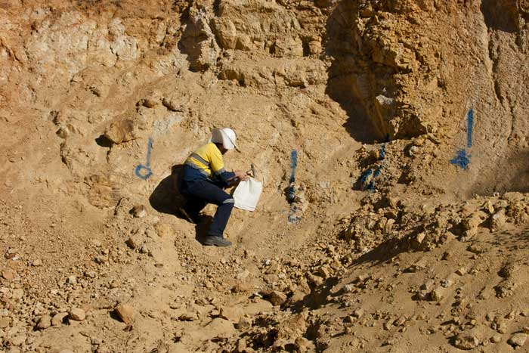
Geologists
Geologists can find out more about ancient environments by studying sedimentary rocks.
The type of sediment in each layer can give us clues about what the environment was like when it was deposited.
Notes:
Photo credit: © Adwo, Shutterstock.com 2018

Slide 7
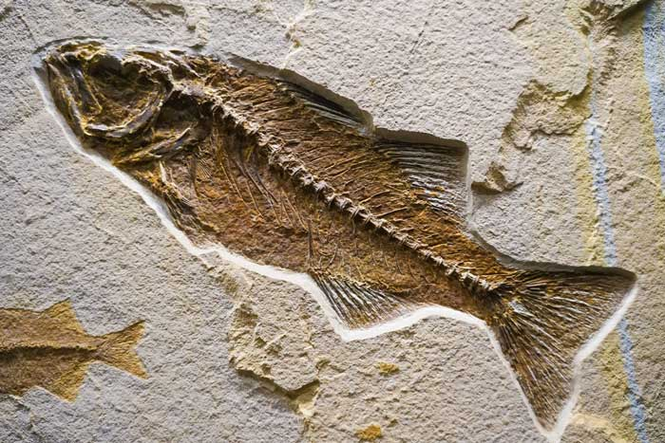
Fossils
Fossils are often found in sedimentary rock. These are the preserved remains of plants or animals.
These are formed when the animal or plant dies and becomes trapped within the sediment.
Fossils come in different forms, such as bones and whole animals. Other evidence of creatures, such as their tracks or waste products, can also become fossilized.
Notes:
Photo credit: © Inspired By Maps, Shutterstock.com 2018

Slide 8
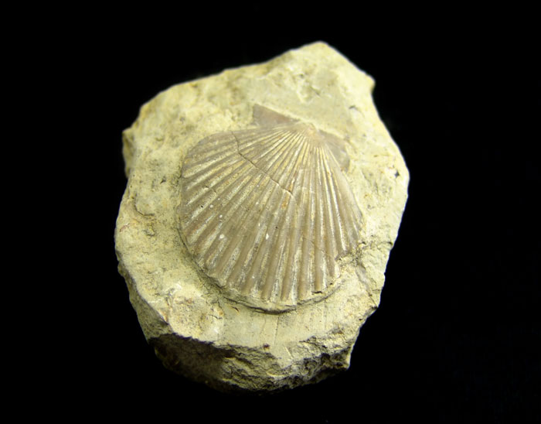
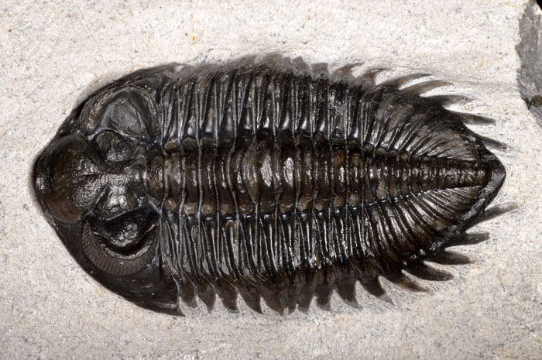
The formation of fossils
Fossils that have formed relatively recently are likely to be of animals and plants we recognize.
Fossils formed a long time ago may contain other creatures, such as trilobites.
Notes:
Photo credits: Scallop fossil © Ricardo Saraiva; Trilobite fossil © Guillermo Guerao Serra, both at Shutterstock.com 2018

Slide 9
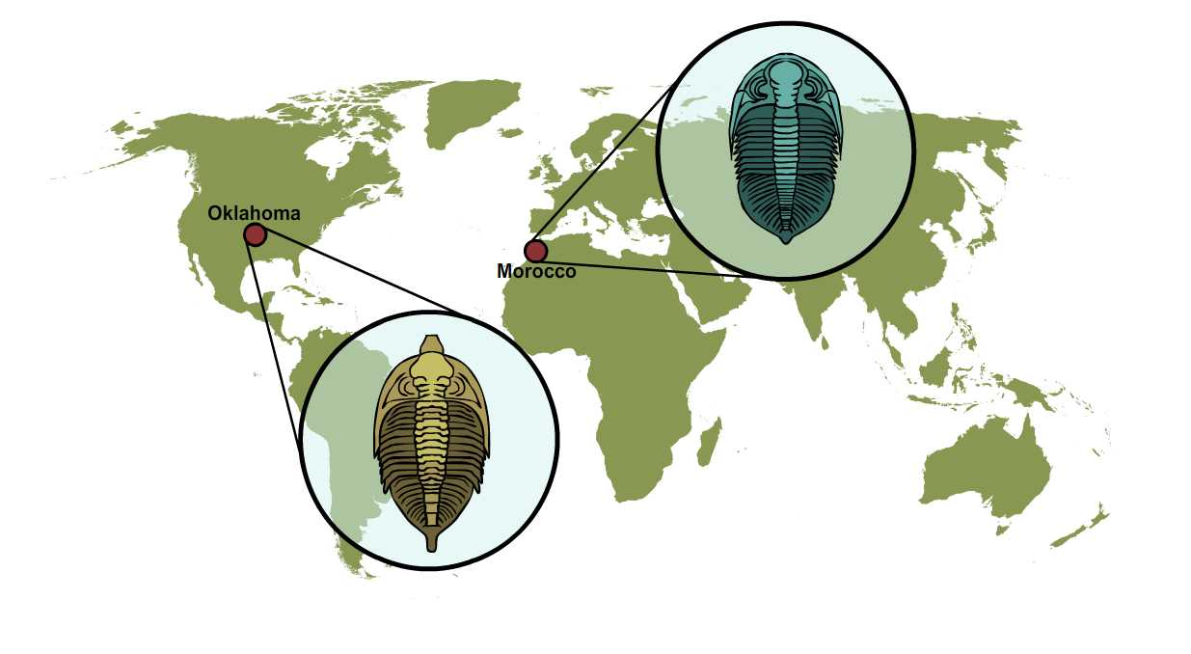
Fossil locations
Sometimes the same fossil is found in different parts of the world.
This can tell us that the rocks are likely to be the same age.
For example, very similar types of trilobite fossils are found in sedimentary rocks both in Morocco and in Oklahoma.
We can conclude that the rocks probably formed at similar times in Earth’s history.

Slide 10
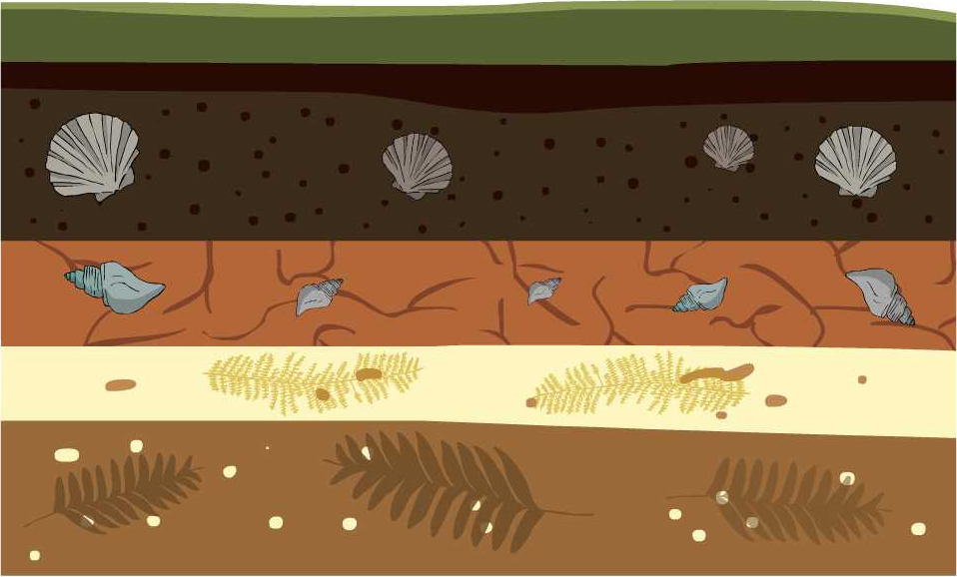
What can fossils show us?
Fossils can tell us more about when the rock formed and what the environment was like at the time.
What information can we gather from these layers of rocks about the changing nature of the environment?
Notes:
Teacher notes
Help students to interpret the diagram. The fossils in the top two layers are from aquatic species. The fossils in the bottom two layers are from terrestrial plant species. You could ask students to do further research into the fossils featured:
Pecten gibbus (from Cenozoic Era)
Neptunea tabulata (from Cenozoic Era)
Ferns
Horsetail plants
This slide covers the Science and Engineering Practices:
Analyzing and Interpreting Data: Analyze and interpret data to make sense of phenomena, using logical reasoning, mathematics and/or computation.
Constructing Explanations and Designing Solutions: Use evidence (e.g., measurements, observations, patterns) to construct or support an explanation or to design a solution to a problem.
Engaging in Argument from Evidence: Construct and/or support an argument with evidence, data and/or a model.

Slide 11
Top layer fossils
We can deduce that the rocks on the top layers formed when there was water in the environment, and that the bottom layers formed when land plants were abundant.
What might have caused this change in the environment?
Notes:
This slide covers the Science and Engineering Practices:
Analyzing and Interpreting Data: Analyze and interpret data to make sense of phenomena, using logical reasoning, mathematics and/or computation.
Constructing Explanations and Designing Solutions: Use evidence (e.g., measurements, observations, patterns) to construct or support an explanation or to design a solution to a problem.
Engaging in Argument from Evidence: Construct and/or support an argument with evidence, data and/or a model.

Slide 12
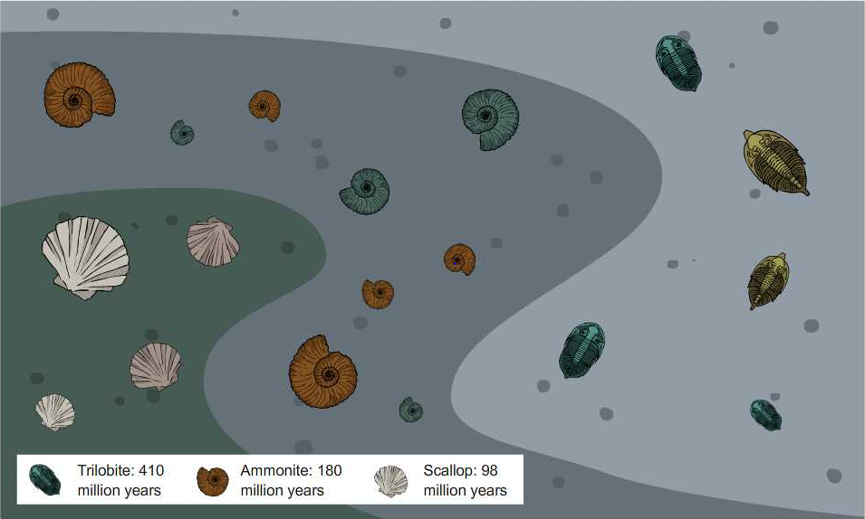
Fossils in sedimentary layers
Sometimes sedimentary layers can get squashed or folded by the Earth’s forces. We can use fossils to help us determine the relative age of the layers.
What can you work out from this image?
Notes:
Teacher notes
Help students to use the key to interpret the diagram. The top layer of rock contains the oldest fossils. The bottom layer contains the youngest fossils. The rocks must have been inverted at some point in their history.
This slide covers the Science and Engineering Practices:
Analyzing and Interpreting Data: Analyze and interpret data to make sense of phenomena, using logical reasoning, mathematics and/or computation.
Constructing Explanations and Designing Solutions: Use evidence (e.g., measurements, observations, patterns) to construct or support an explanation or to design a solution to a problem.
Engaging in Argument from Evidence: Construct and/or support an argument with evidence, data and/or a model.

Slide 13
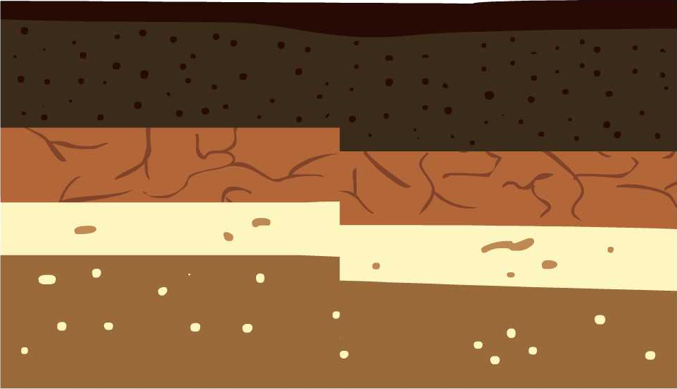
Earthquakes
Earthquakes can also result in layers no longer being aligned.
fault line
When a sedimentary rock has been impacted by an earthquake, there will often be change at the fault line where the earthquake occurred.

Slide 14
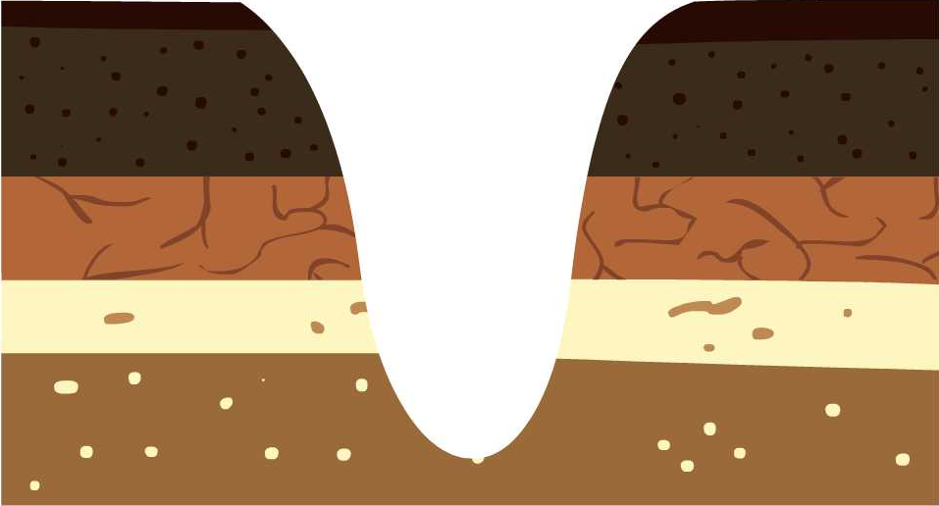
Erosion
What do you think has caused this change to the rock formation? And how?
water
Rivers are a strong force that can erode sedimentary rock. Here, the river has cut through, exposing the rock layers.
Notes:
Teacher notes
You could mention that the river may now deposit new sediment, building up new sedimentary rock within the gap.
This slide covers the Science and Engineering Practices:
Analyzing and Interpreting Data: Analyze and interpret data to make sense of phenomena, using logical reasoning, mathematics and/or computation.
Constructing Explanations and Designing Solutions: Use evidence (e.g., measurements, observations, patterns) to construct or support an explanation or to design a solution to a problem.
Engaging in Argument from Evidence: Construct and/or support an argument with evidence, data and/or a model.

